Slide 1
Machine Learning Assignment
Ujjwal Sharma - BT18CSE021
Chinmay Hattewar - BT18CSE055

Slide 2
CLASSIFICATION PROBLEM
(Predict whether a mammogram mass is benign or malignant)
MODEL USED :
DECISION TREES
RANDOM FORESTS
K-MEANS AND KNN
SUPPORT VECTOR MACHINE
NAIVE BAYES
ARTIFICIAL NEURAL NETWORK

Slide 3
DATASET

Slide 4
Mammographic Mass Data
Original owners of database:
Prof. Dr. Rüdiger Schulz-Wendtland
Institute of Radiology, Gynaecological Radiology,
University Erlangen-Nuremberg
91054 Erlangen, Germany
B. Donor of database:
Matthias Elter
Fraunhofer Institute for Integrated Circuits (IIS)
Image Processing and Medical Engineering Department (BMT)
Am Wolfsmantel 33
91058 Erlangen, Germany
matthias.elter@iis.fraunhofer.de
(49) 9131-7767327

Slide 5
Relevant
Information
This data set can be used to predict the severity (benign or malignant) of a mammographic mass lesion from BI-RADS attributes and the patient's age. It contains a BI-RADS assessment, the patient's age and three BI-RADS attributes together with the ground truth (the severity field) for 516 benign and 445 malignant masses that have been identified on full field digital mammograms collected at the Institute of Radiology of the University Erlangen-Nuremberg between 2003 and 2006. Each instance has an associated BI-RADS assessment ranging from 1 (definitely benign) to 5 (highly suggestive of malignancy) assigned in a double-review process by physicians. Assuming that all cases with BI-RADS assessments greater or equal a given value (varying from 1 to 5), are malignant and the other cases benign, sensitivities and associated specificities can be calculated. These can be an indication of how well a CAD system performs compared to the radiologists.
Mammography is the most effective method for breast cancer screening available today. However, the low positive predictive value of breast biopsy resulting from mammogram interpretation leads to approximately 70% unnecessary biopsies with benign outcomes. To reduce the high number of unnecessary breast biopsies, several computer-aided diagnosis (CAD) systems have been proposed in the last years.These systems help physicians in their decision to perform a breast biopsy on a suspicious lesion seen in a mammogram or to perform a short term follow-up examination instead.

Slide 6
Information Regarding Dataset
1. Number of Instances: 961
2. Number of Attributes: 6 (1 goal field, 1 non-predictive, 4 predictive attributes)
3. Attribute Information:
1. BI-RADS assessment: 1 to 5 (ordinal)
2. Age: patient's age in years (integer)
3. Shape: mass shape: round=1 oval=2 lobular=3 irregular=4 (nominal)
4. Margin: mass margin: circumscribed=1 microlobulated=2 obscured=3 ill-defined=4 spiculated=5 (nominal)
5. Density: mass density high=1 iso=2 low=3 fat-containing=4 (ordinal)
6. Severity: benign=0 or malignant=1 (binominal)

Slide 7
Information Regarding Dataset
4. Missing Attribute Values: Yes
- BI-RADS assessment: 2
- Age: 5
- Shape: 31
- Margin: 48
- Density: 76
- Severity: 0
5. Class Distribution: benign: 516; malignant: 445

Slide 8
CLASSIFICATION
MODELS

Slide 9
DECISION TREE

Slide 10
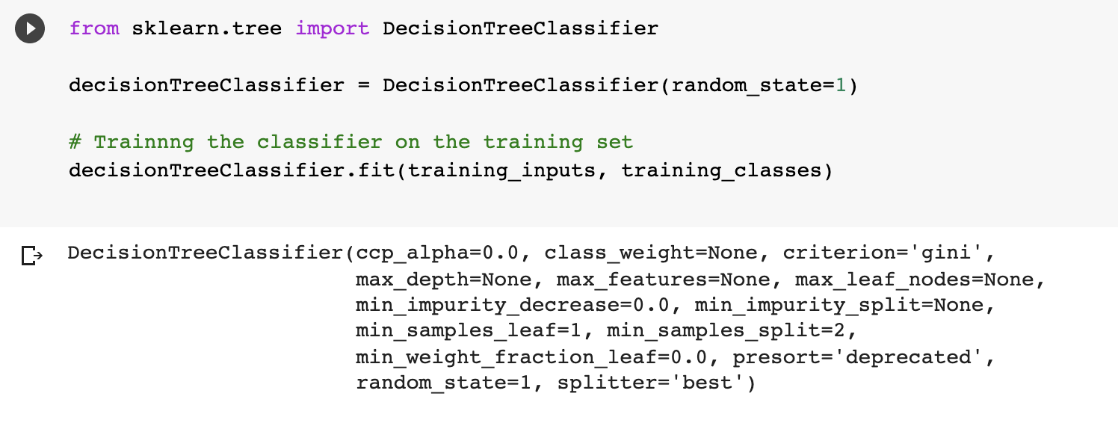
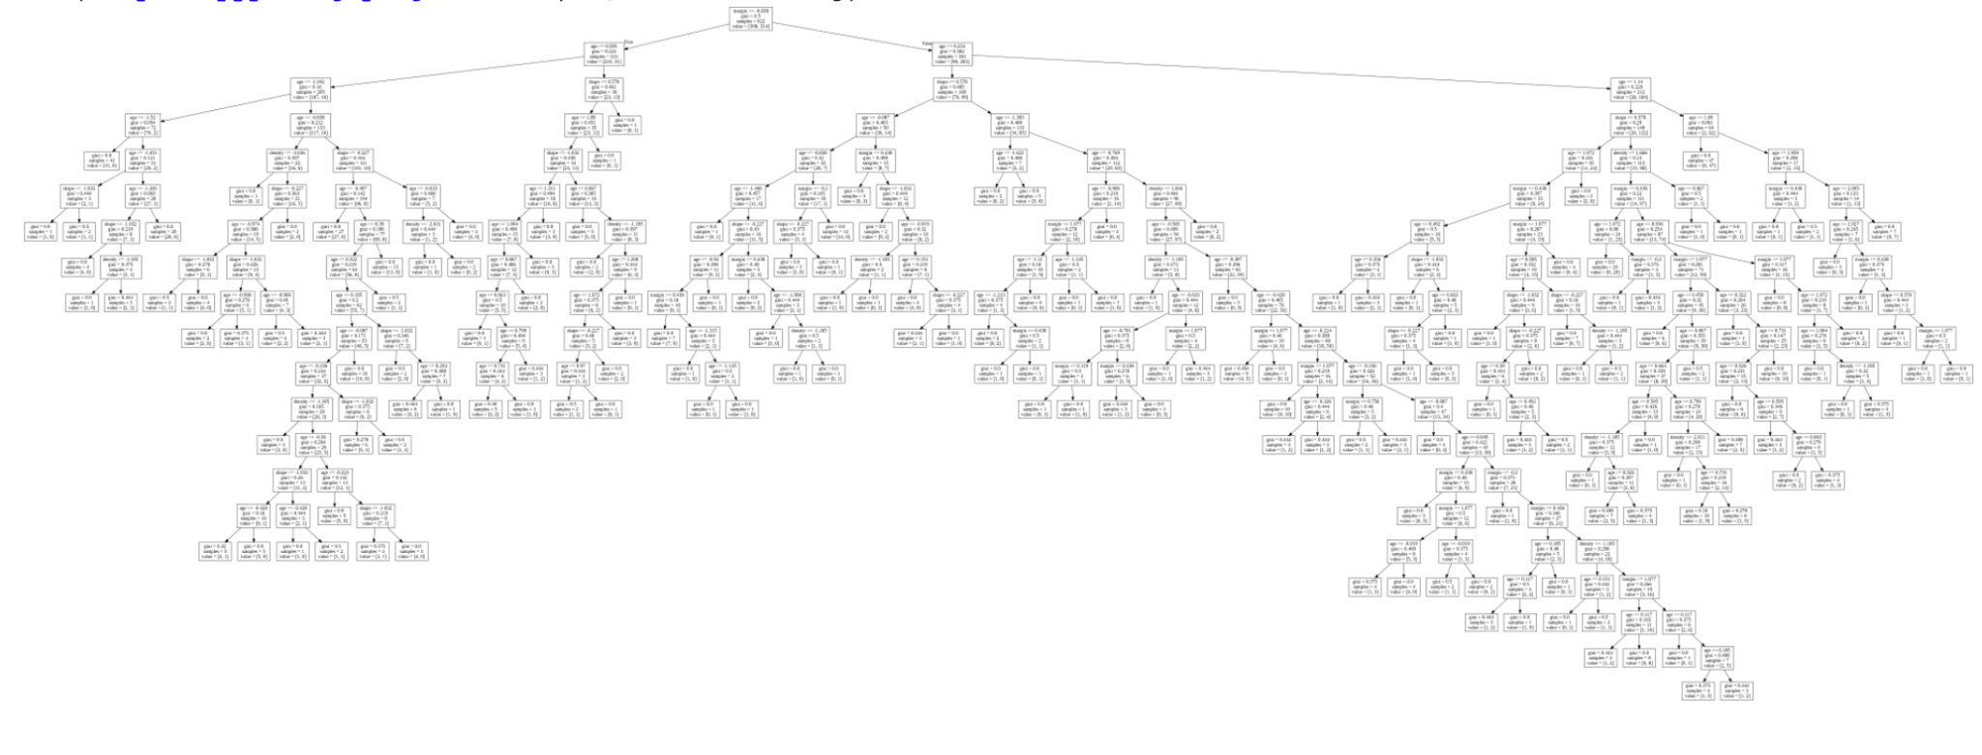
API USED FROM SKLEARN
Final Decision Tree

Slide 11
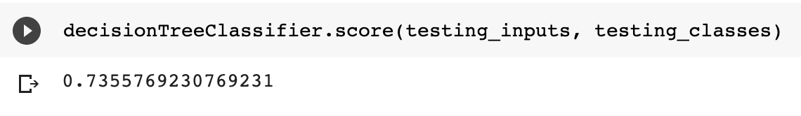
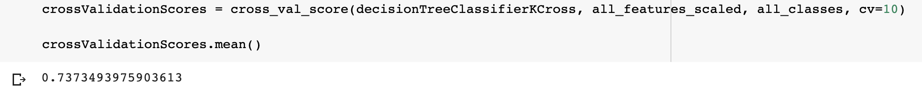
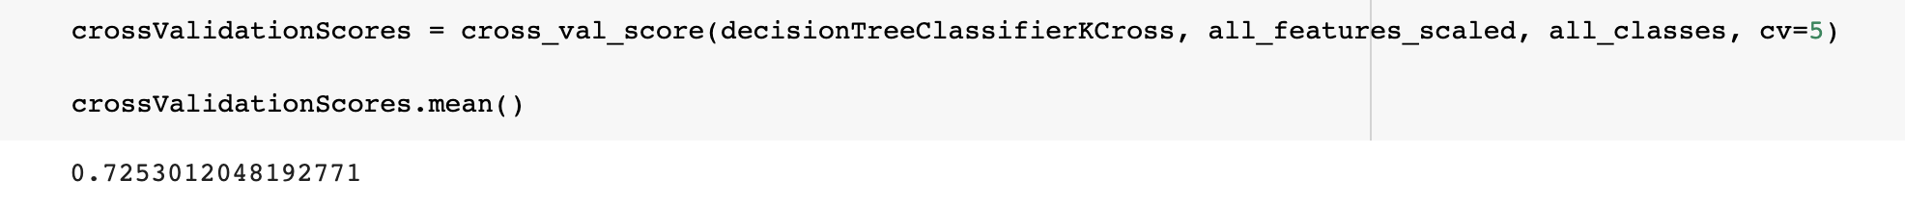
Accuracy Of Decision Tree
Train-Test with 75% split :
K-Cross Validation with k = 10
K-Cross Validation with k = 5

Slide 12
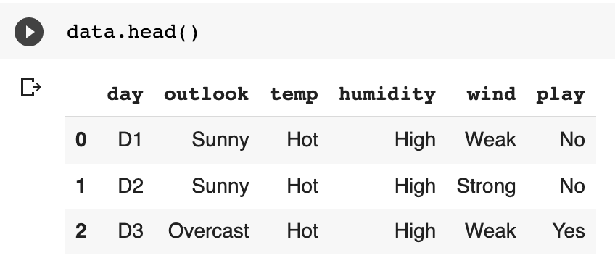
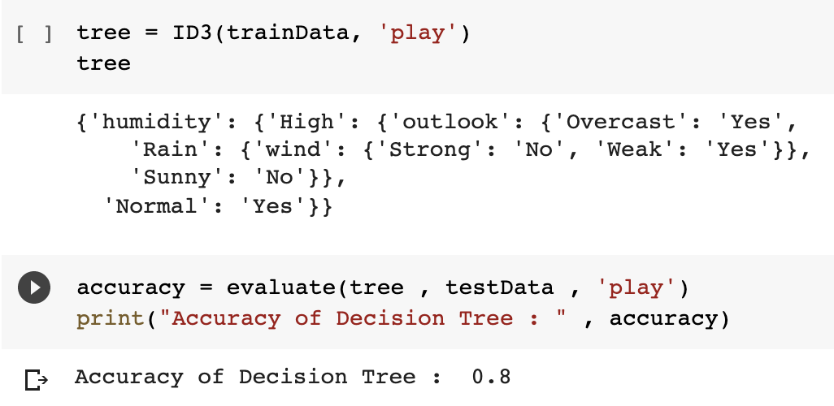
DECISION TREE
Self Implemented
Dataset Used - Play Tennis
https://www.kaggle.com/fredericobreno/play-tennis
Test-Train split 70%

Slide 13
Advantages Of Decision Tree
1. Clear Visualization: The algorithm is simple to understand, interpret and visualize as the idea is mostly used in our daily lives. Output of a Decision Tree can be easily interpreted by humans.
2. Simple and easy to understand: Decision Tree looks like simple if-else statements which are very easy to understand.
3. Decision Tree can be used for both classification and regression problems.
4. Decision Tree can handle both continuous and categorical variables.
5. No feature scaling required: No feature scaling (standardization and normalization) required in case of Decision Tree as it uses rule based approach instead of distance calculation.
6. Handles non-linear parameters efficiently: Non linear parameters don't affect the performance of a Decision Tree unlike curve based algorithms. So, if there is high nonlinearity between the independent variables, Decision Trees may outperform as compared to other curve based algorithms.
7. Decision Tree can automatically handle missing values.
8. Decision Tree is usually robust to outliers and can handle them automatically.
9. Less Training Period: Training period is less as compared to Random Forest because it generates only one tree unlike forest of trees in the Random Forest.

Slide 14
Disadvantages Of Decision Tree
1. Overfitting: This is the main problem of the Decision Tree. It generally leads to overfitting of the data which ultimately leads to wrong predictions. In order to fit the data (even noisy data), it keeps generating new nodes and ultimately the tree becomes too complex to interpret. In this way, it loses its generalization capabilities. It performs very well on the trained data but starts making a lot of mistakes on the unseen data.
2. High variance: As mentioned in point 1, Decision Tree generally leads to the overfitting of data. Due to the overfitting, there are very high chances of high variance in the output which leads to many errors in the final estimation and shows high inaccuracy in the results. In order to achieve zero bias (overfitting), it leads to high variance.
3. Unstable: Adding a new data point can lead to re-generation of the overall tree and all nodes need to be recalculated and recreated.
4. Affected by noise: Little bit of noise can make it unstable which leads to wrong predictions.
5. Not suitable for large datasets: If data size is large, then one single tree may grow complex and lead to overfitting. So in this case, we should use Random Forest instead of a single Decision Tree.

Slide 15
Random Forest
Ensemble Approach

Slide 16
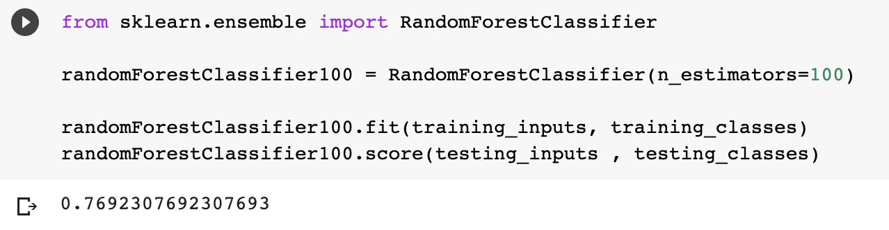
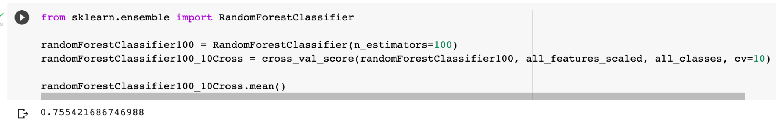
API USED FROM SKLEARN
TOTAL ESTIMATORS = 100
K-Cross Validation

Slide 17
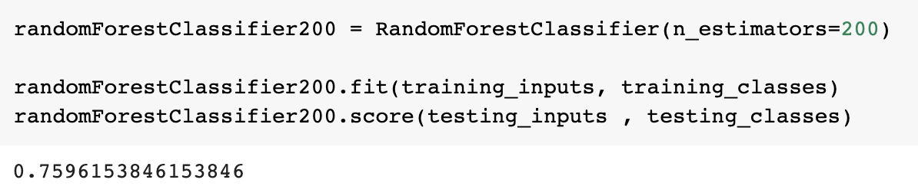
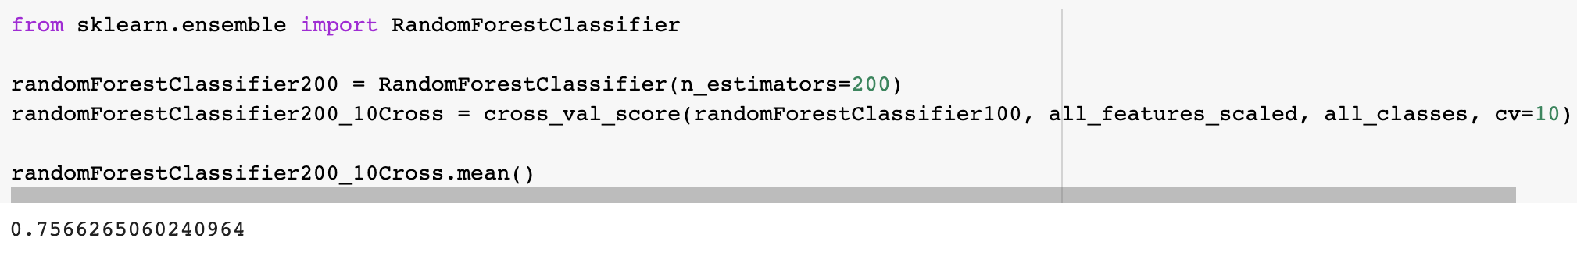
API USED FROM SKLEARN
TOTAL ESTIMATORS = 200
K-Cross Validation

Slide 18
Advantages Of Random Forest
1. Random Forest is based on the bagging algorithm and uses Ensemble Learning technique. It creates as many trees on the subset of the data and combines the output of all the trees. In this way it reduces overfitting problem in decision trees and also reduces the variance and therefore improves the accuracy.
2. Random Forest can be used to solve both classification as well as regression problems.
3. Random Forest works well with both categorical and continuous variables.
4. Random Forest can automatically handle missing values.
5. No feature scaling required: No feature scaling (standardization and normalization) required in case of Random Forest as it uses rule based approach instead of distance calculation.
6. Handles non-linear parameters efficiently: Non linear parameters don't affect the performance of a Random Forest unlike curve based algorithms. So, if there is high non-linearity between the independent variables, Random Forest may outperform as compared to other curve based algorithms.
7. Random Forest can automatically handle missing values.
8. Random Forest is usually robust to outliers and can handle them automatically.
9. Random Forest algorithm is very stable. Even if a new data point is introduced in the dataset, the overall algorithm is not affected much since the new data may impact one tree, but it is very hard for it to impact all the trees.
10. Random Forest is comparatively less impacted by noise.

Slide 19
Disadvantages Of Random Forest
1. Complexity: Random Forest creates a lot of trees (unlike only one tree in case of decision tree) and combines their outputs. By default, it creates 100 trees in Python sklearn library. To do so, this algorithm requires much more computational power and resources. On the other hand decision tree is simple and does not require so much computational resources.
2. Longer Training Period: Random Forest require much more time to train as compared to decision trees as it generates a lot of trees (instead of one tree in case of decision tree) and makes decision on the majority of votes.

Slide 20
K-Means And KNN

Slide 21
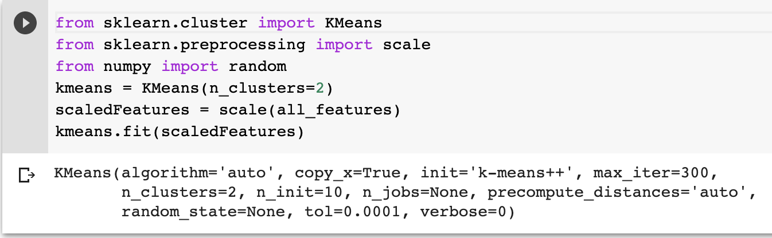
API USED FROM SKLEARN for KMEANS
Final Decision Tree

Slide 22
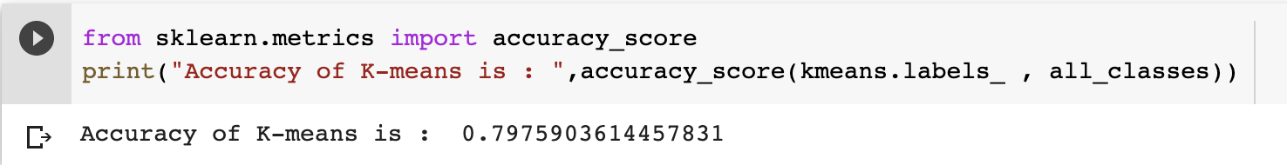
Accuracy of K-Means
Here labels actually don't have any meaning unless i specify
So in this case i have specified 0 as No and 1 as Yes

Slide 23
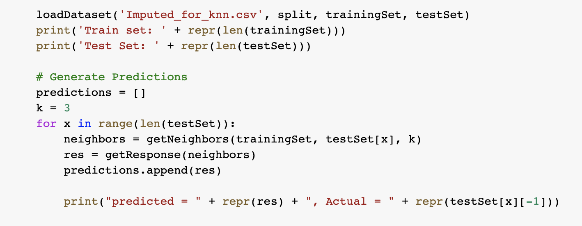
KNN
Self Implemented

Slide 24
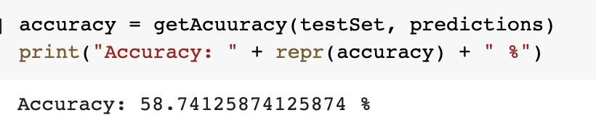
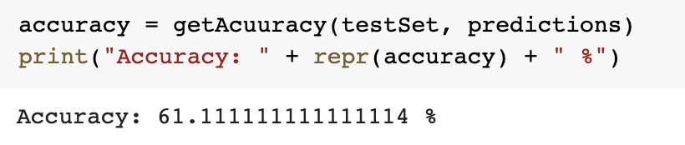
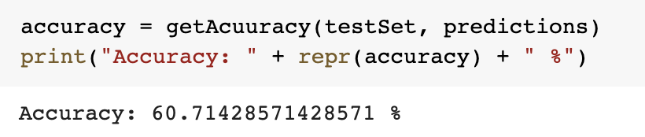
Accuracy of KNN
For k = 3
For k = 5
For k = 7

Slide 25
Advantages Of K-Means
Relatively simple to implement.
Scales to large data sets.
Guarantees convergence.
Can warm-start the positions of centroids.
Easily adapts to new examples.
Generalizes to clusters of different shapes and sizes, such as elliptical clusters.

Slide 26
Disadvantages Of K-Means
Choosing K manually.
Being dependent on initial values.
For a low k, you can mitigate this dependence by running k-means several times with different initial values and picking the best result. As k increases, you need advanced versions of k-means to pick better values of the initial centroids (called k-means seeding).
Clustering data of varying sizes and density.
k-means has trouble clustering data where clusters are of varying sizes and density. To cluster such data, you need to generalize k-means .
Clustering outliers.
Centroids can be dragged by outliers, or outliers might get their own cluster instead of being ignored. Consider removing or clipping outliers before clustering.
Scaling with number of dimensions.
As the number of dimensions increases, a distance-based similarity measure converges to a constant value between any given examples. Reduce dimensionality either by using PCA on the feature data, or by using “spectral clustering” to modify the clustering algorithm as explained below.

Slide 27
SUPPORT VECTOR MACHINE

Slide 28
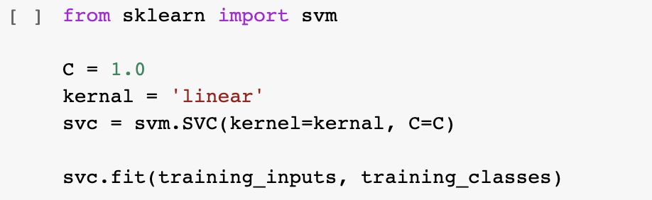
API USED FROM SKLEARN
K-Cross Validation

Slide 29
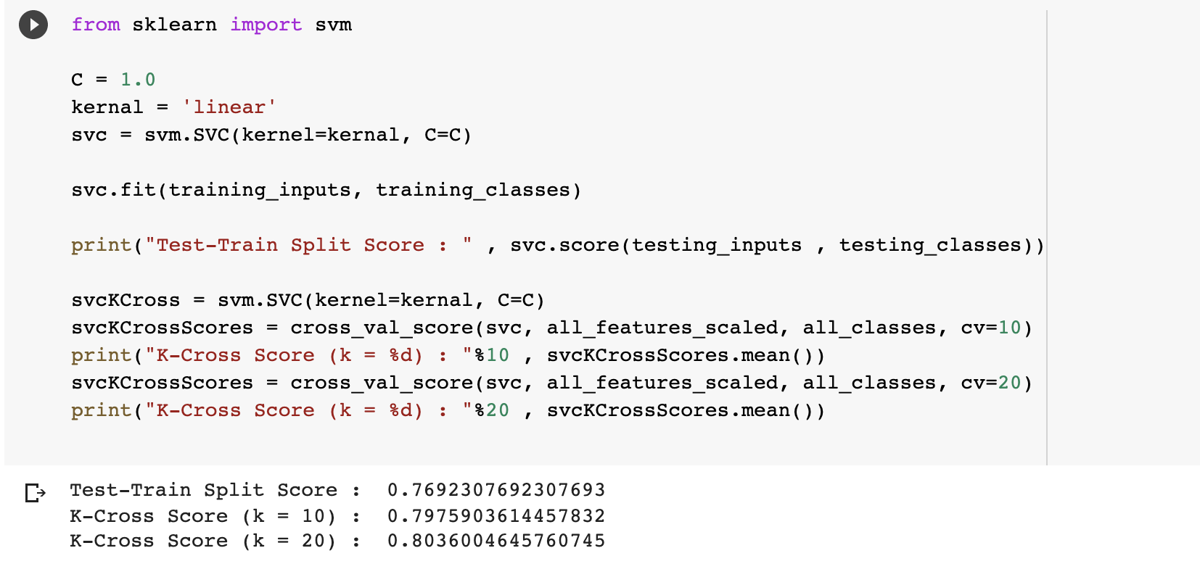
Accuracy of SVM Linear Kernel

Slide 30
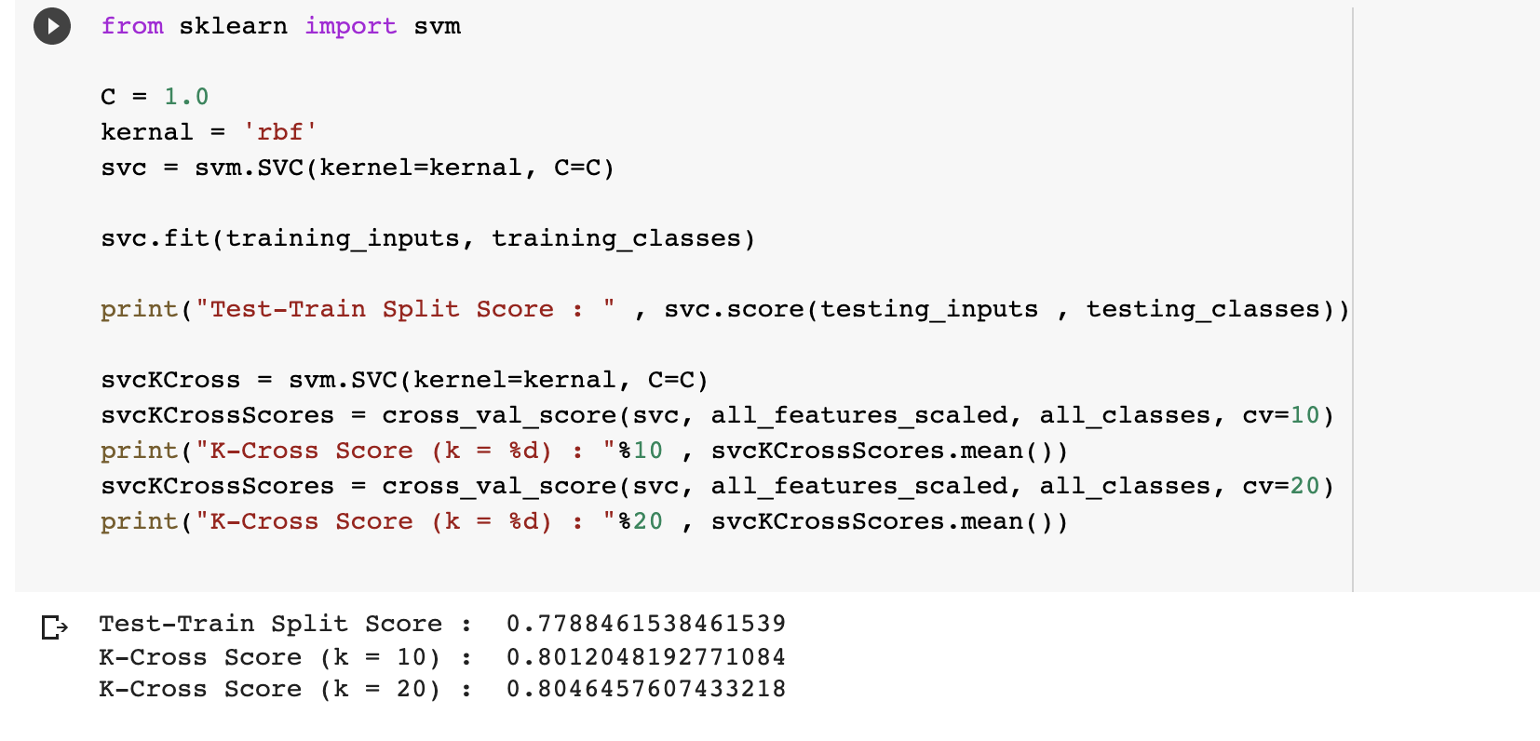
Accuracy of SVM RBF Kernel

Slide 31
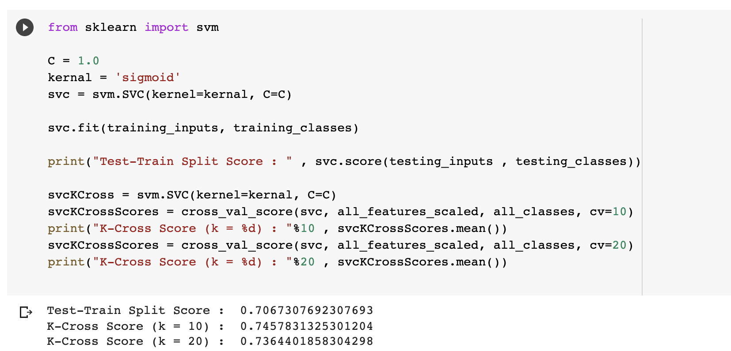
Accuracy of SVM Sigmoid Kernel

Slide 32
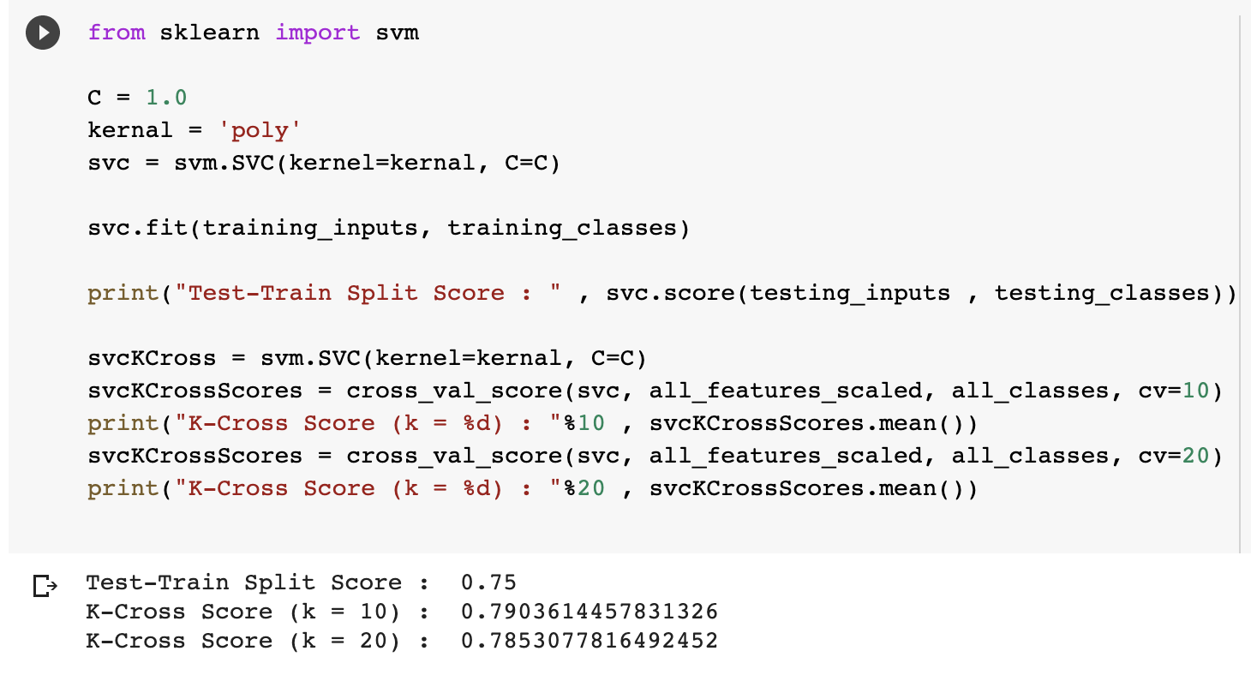
Accuracy of SVM Polynomial Kernel

Slide 33
Advantages Of Support Vector Machine
1. Regularization capabilities: SVM has L2 Regularization feature. So, it has good generalization capabilities which prevent it from over-fitting.
2. Handles non-linear data efficiently: SVM can efficiently handle non-linear data using Kernel trick.
3. Solves both Classification and Regression problems: SVM can be used to solve both classification and regression problems. SVM is used for classification problems while SVR (Support Vector Regression) is used for regression problems.
4. Stability: A small change to the data does not greatly affect the hyperplane and hence the SVM. So the SVM model is stable.

Slide 34
Disadvantages Of Support Vector Machine
1. Choosing an appropriate Kernel function is difficult: Choosing an appropriate Kernel function (to handle the non-linear data) is not an easy task. It could be tricky and complex. In case of using a high dimension Kernel, you might generate too many support vectors which reduce the training speed drastically.
2. Extensive memory requirement: Algorithmic complexity and memory requirements of SVM are very high. You need a lot of memory since you have to store all the support vectors in the memory and this number grows abruptly with the training dataset size.
3. Requires Feature Scaling: One must do feature scaling of variables before applying SVM.
4. Long training time: SVM takes a long training time on large datasets.
5. Difficult to interpret: SVM model is difficult to understand and interpret by human beings unlike Decision Trees.

Slide 35
NAIVE BAYES

Slide 36
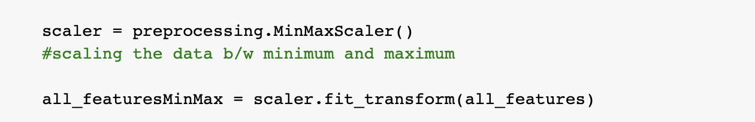
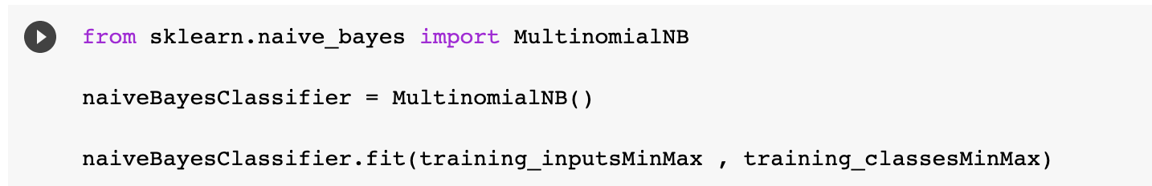
API USED FROM SKLEARN

Slide 37
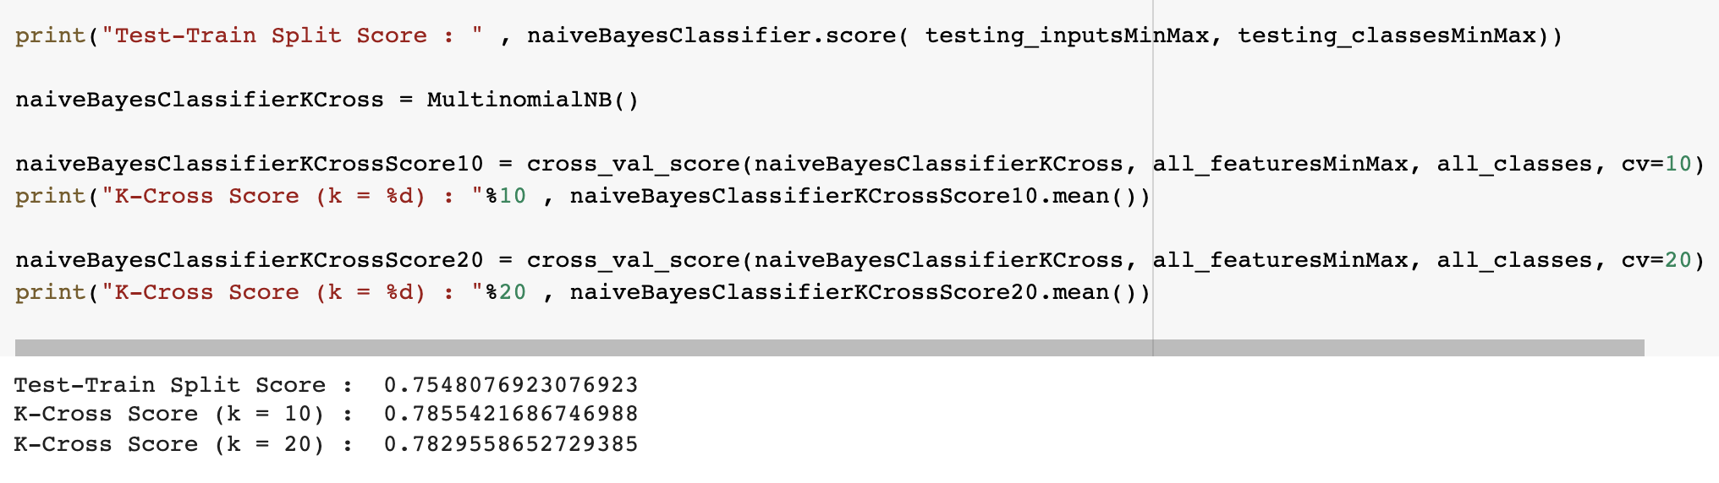
Accuracy of Naive Bayes

Slide 38
Advantages Of Naive Bayes
1. When assumption of independent predictors holds true, a Naive Bayes classifier performs better as compared to other models.
2. Naive Bayes requires a small amount of training data to estimate the test data. So, the training period is less.
3. Naive Bayes is also easy to implement.

Slide 39
Disadvantages Of Naive Bayes
1. Main imitation of Naive Bayes is the assumption of independent predictors. Naive Bayes implicitly assumes that all the attributes are mutually independent. In real life, it is almost impossible that we get a set of predictors which are completely independent.
2. If categorical variable has a category in test data set, which was not observed in training data set, then model will assign a 0 (zero) probability and will be unable to make a prediction. This is often known as Zero Frequency. To solve this, we can use the smoothing technique. One of the simplest smoothing techniques is called Laplace estimation.

Slide 40
ARTIFICIAL NEURAL NETWORKS

Slide 41
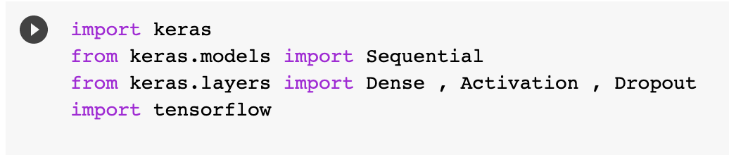
API USED FROM KERAS
(TENSORFLOW)

Slide 42
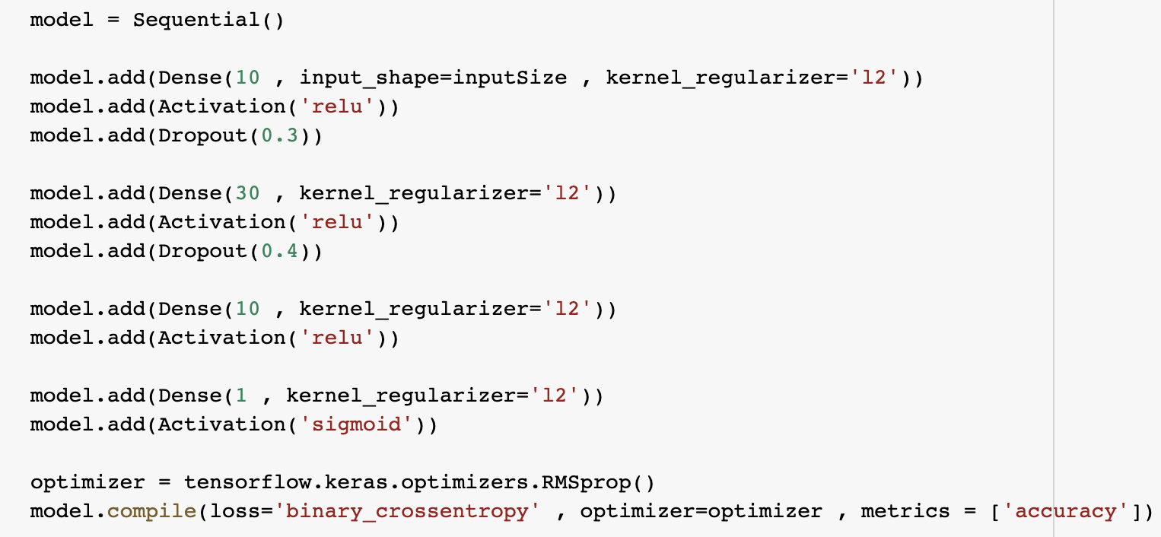
API USED FROM KERAS
(TENSORFLOW)
ADDING OPTIMIZER , DROPOUT AND REGULARISATION (L2) TO AVOID OVERFITTING

Slide 43
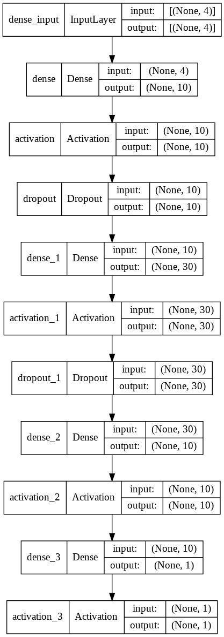
Visual Representation Of Model

Slide 44
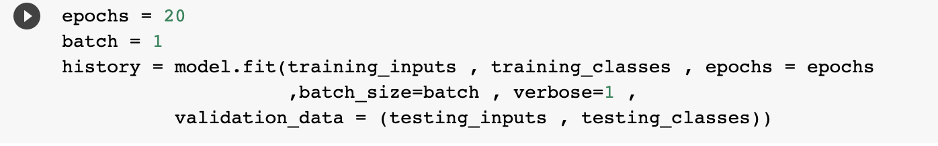
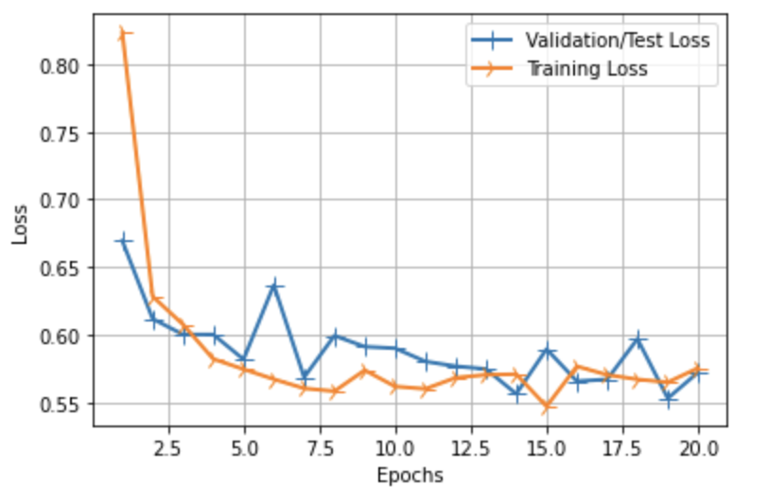
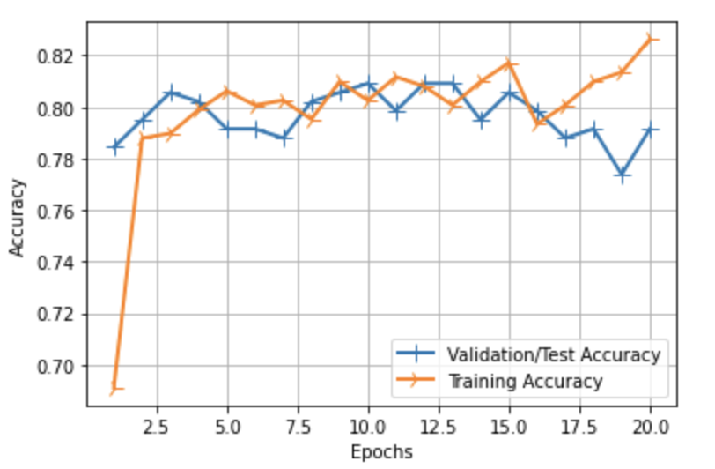
Accuracy after 20 epochs
Test-Train Split 66% , batchSize = 1
Graph of Loss VS Epochs Of the Model
Graph of Accuracy VS Epochs Of the Model

Slide 45
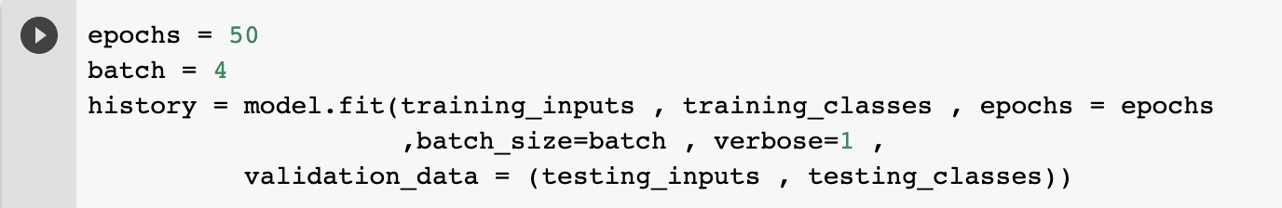
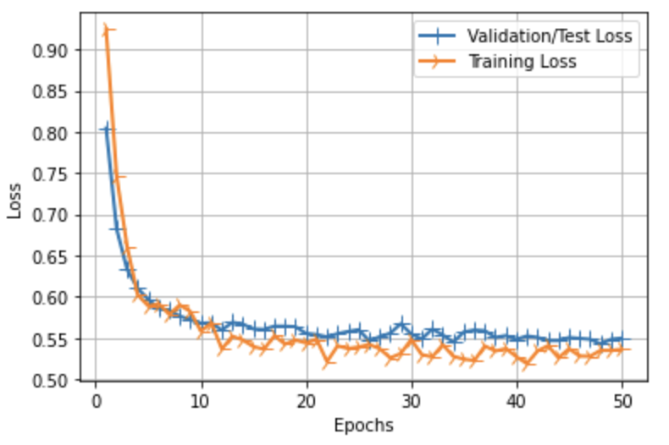
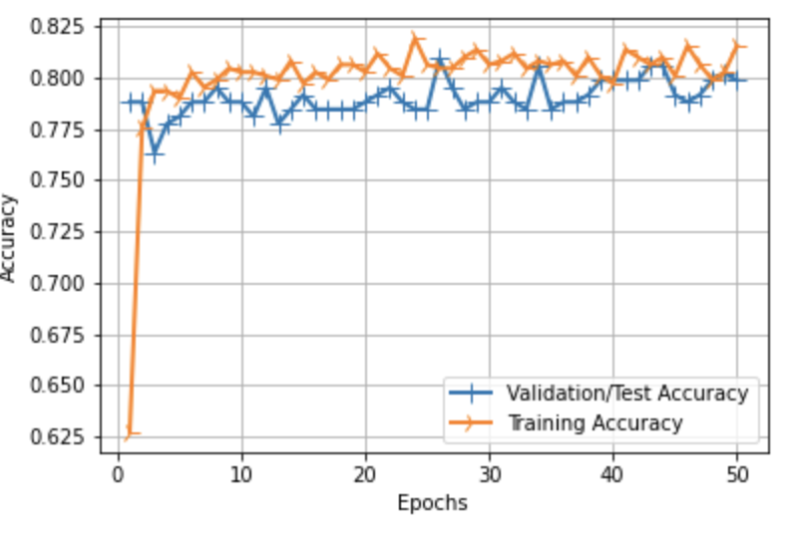
Accuracy after 50 epochs
Test-Train Split 66% , batchSize = 4
Graph of Loss VS Epochs Of the Model
Graph of Accuracy VS Epochs Of the Model

Slide 46
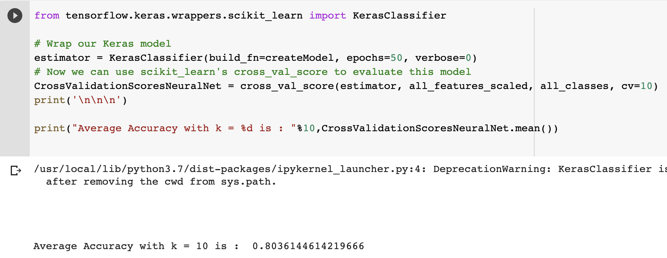
K-Cross Validation

Slide 47
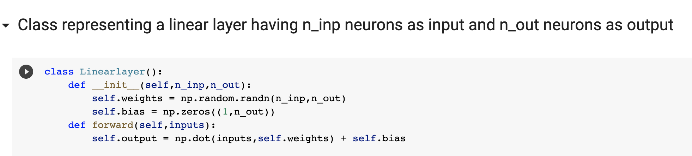
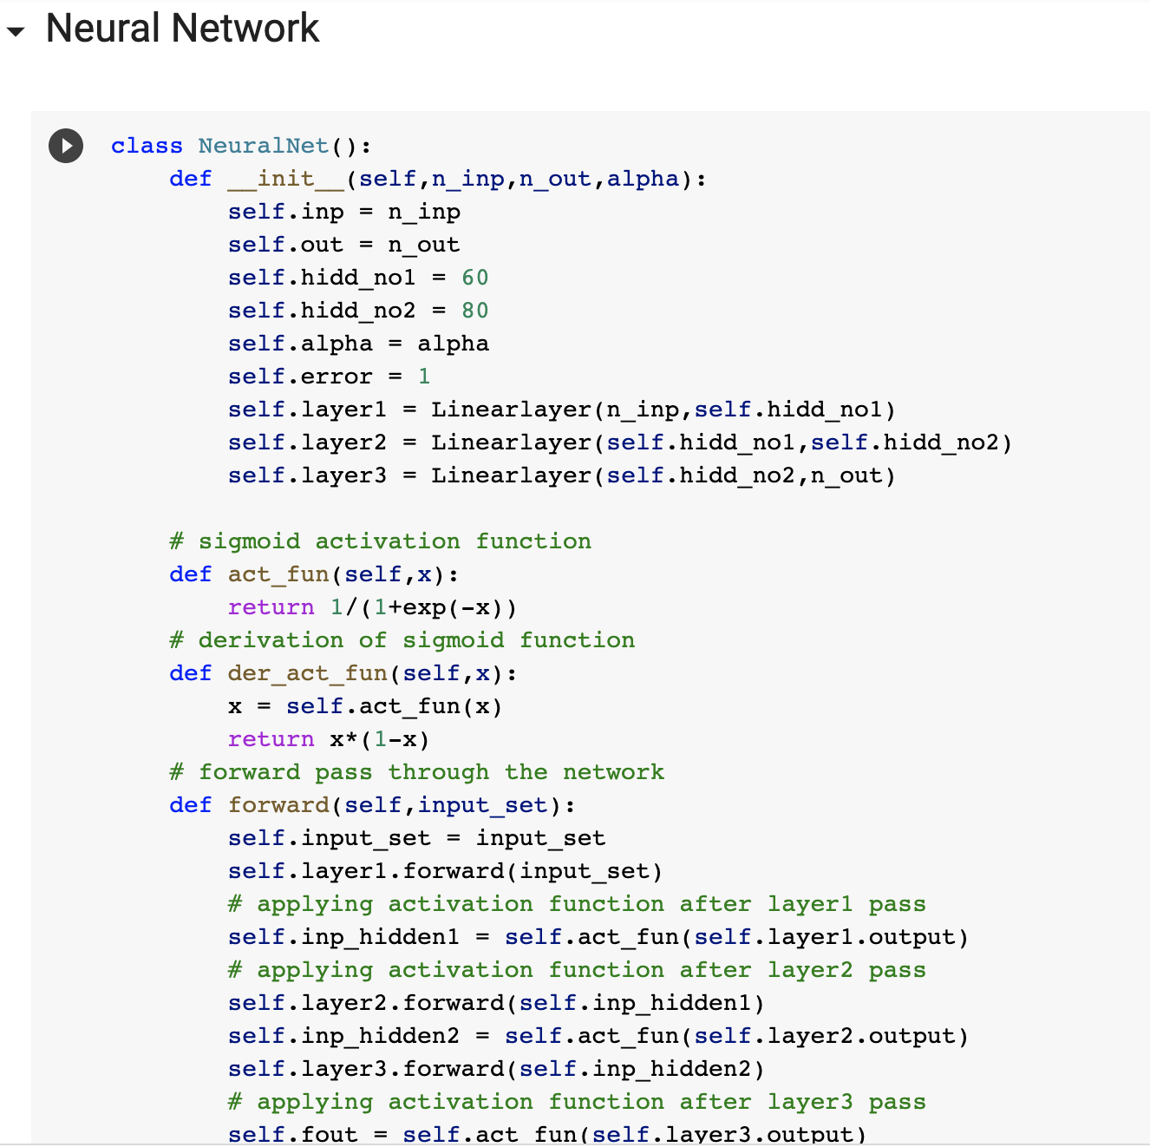
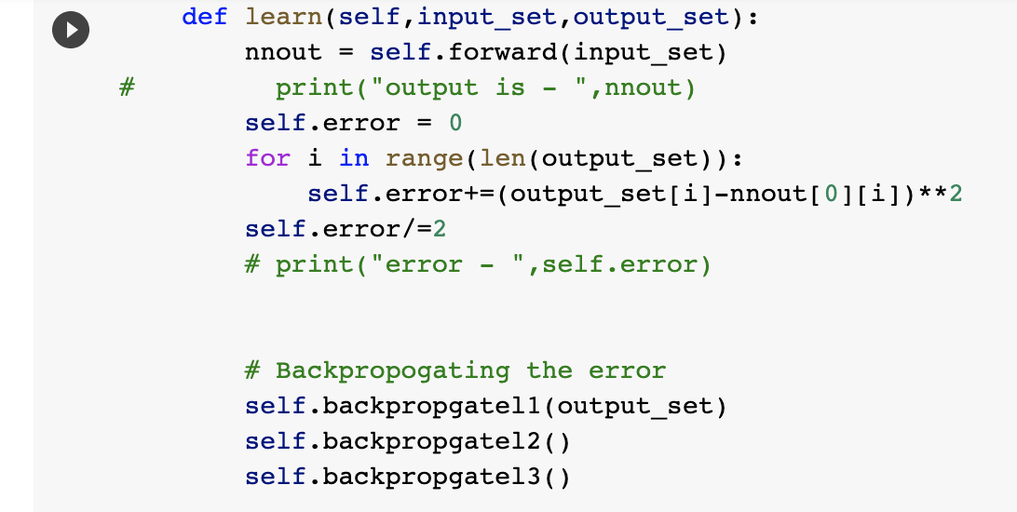
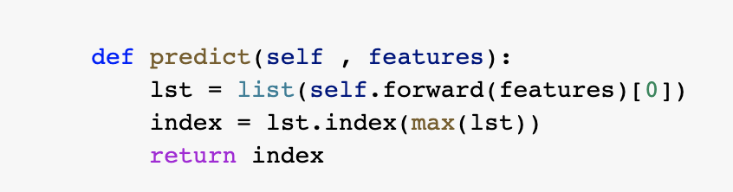
Artificial Neural Network
(Self Implemented with backpropagation upto 3 layers)

Slide 48
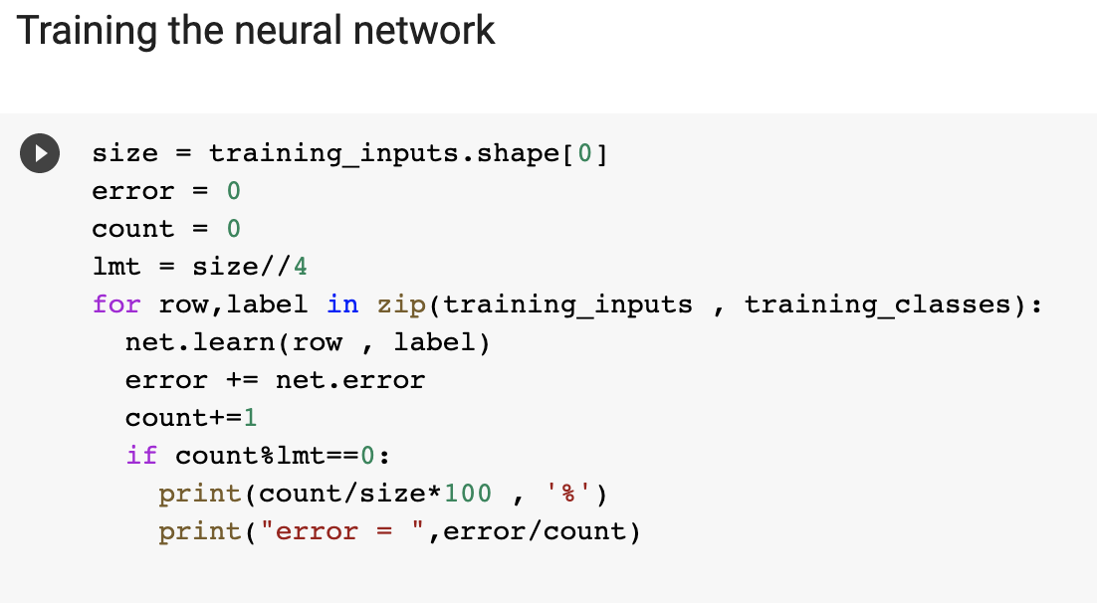
Artificial Neural Network
(Self Implemented with backpropagation upto 3 layers)

Slide 49
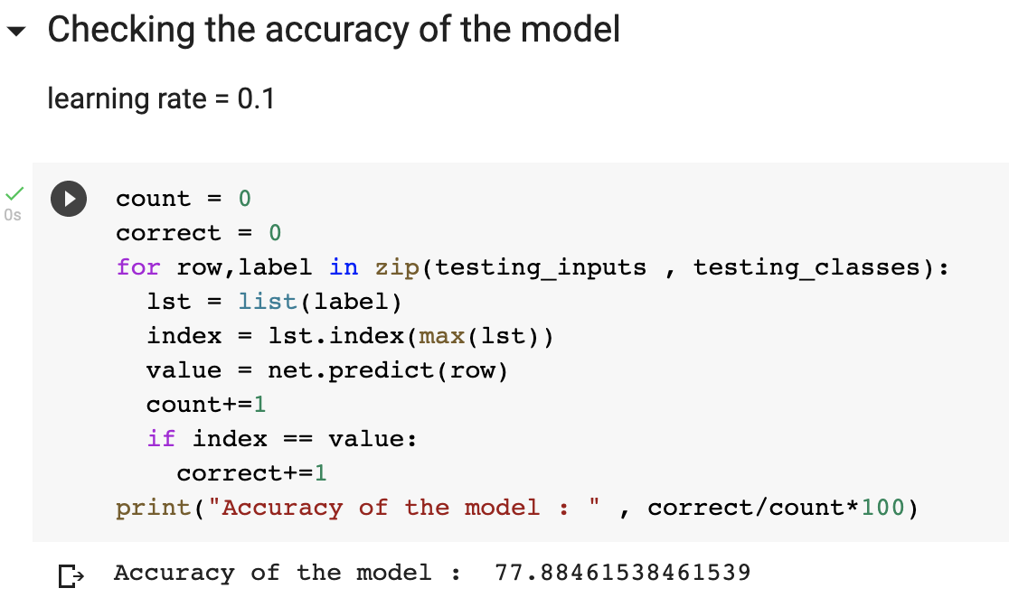
Accuracy of self implemented Neural Network
Learning Rate = 0.1 , 10 Epochs

Slide 50
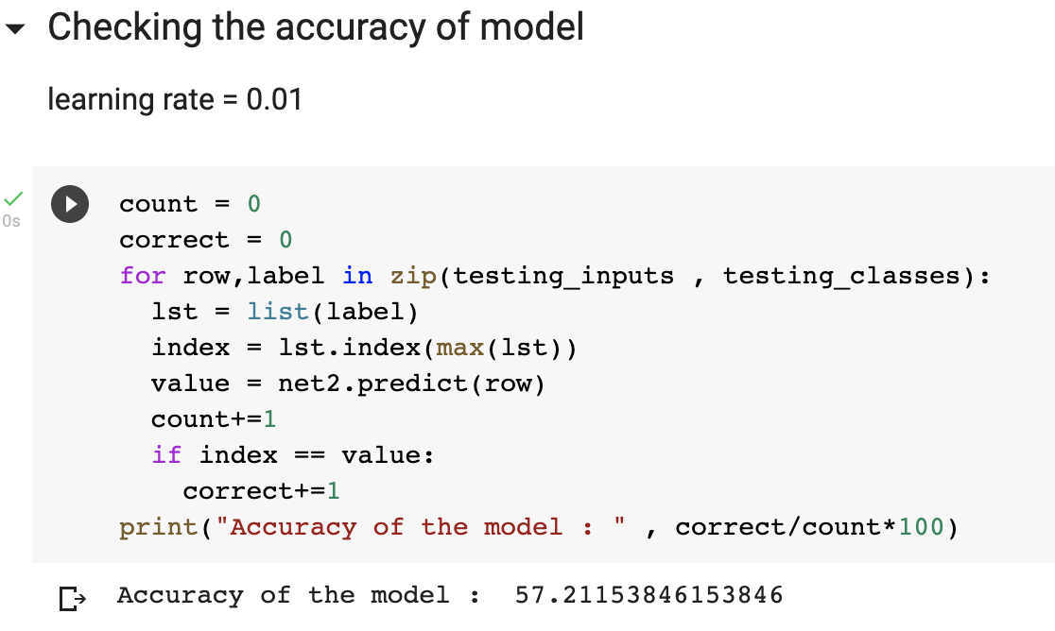
Accuracy of self implemented Neural Network
Learning Rate = 0.01 , 10 Epochs

Slide 51
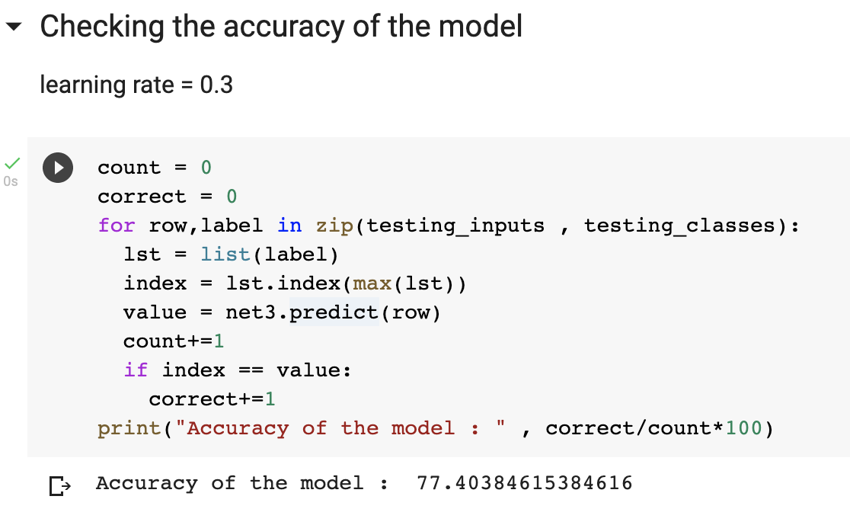
Accuracy of self implemented Neural Network
Learning Rate = 0.3 , 10 Epochs

Slide 52
Advantages Of Artificial Neural Networks
Problems in ANN are represented by attribute-value pairs.
ANNs are used for problems having the target function, the output may be discrete-valued, real-valued, or a vector of several real or discrete-valued attributes.
ANN learning methods are quite robust to noise in the training data. The training examples may contain errors, which do not affect the final output.
It is used where the fast evaluation of the learned target function required.
ANNs can bear long training times depending on factors such as the number of weights in the network, the number of training examples considered, and the settings of various learning algorithm parameters.

Slide 53
Disadvantages Of Artificial Neural Networks
Hardware Dependence:
Artificial Neural Networks require processors with parallel processing power, by their structure.
For this reason, the realization of the equipment is dependent.
Unexplained functioning of the network:
This the most important problem of ANN.
When ANN gives a probing solution, it does not give a clue as to why and how.
This reduces trust in the network.
Assurance of proper network structure:
There is no specific rule for determining the structure of artificial neural networks.
The appropriate network structure is achieved through experience and trial and error.

Slide 54
Disadvantages Of Artificial Neural Networks
The difficulty of showing the problem to the network:
ANNs can work with numerical information.
Problems have to be translated into numerical values before being introduced to ANN.
The display mechanism to be determined will directly influence the performance of the network.
This is dependent on the user's ability.
The duration of the network is unknown:
The network is reduced to a certain value of the error on the sample means that the training has been completed.
The value does not give us optimum results.

Slide 55
Some Other Techniques

Slide 56
Principal Component Analysis
(PCA)

Slide 57
The principal components of a collection of points in a real coordinate space are a sequence of unit vectors, where the -th vector is the direction of a line that best fits the data while being orthogonal to the first vectors. Here, a best-fitting line is defined as one that minimizes the average squared distance from the points to the line. These directions constitute an orthonormal basis in which different individual dimensions of the data are linearly uncorrelated. Principal component analysis (PCA) is the process of computing the principal components and using them to perform a change of basis on the data, sometimes using only the first few principal components and ignoring the rest.
WIKIPEDIA
Simple Definition
PCA is a dimensionality reduction technique; it lets you distill multi-dimensional data down to fewer dimensions, selecting new dimensions that preserve variance in the data as best it can.

Slide 58
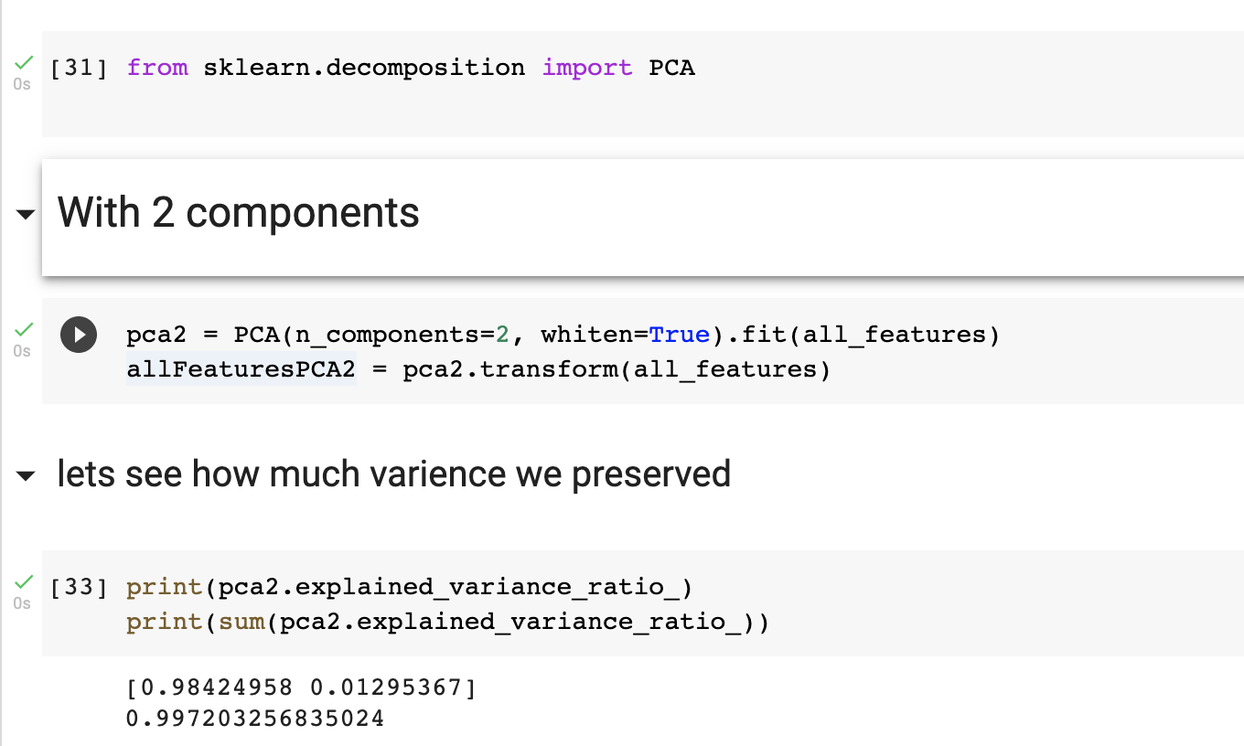
API USED FROM SKLEARN

Slide 59
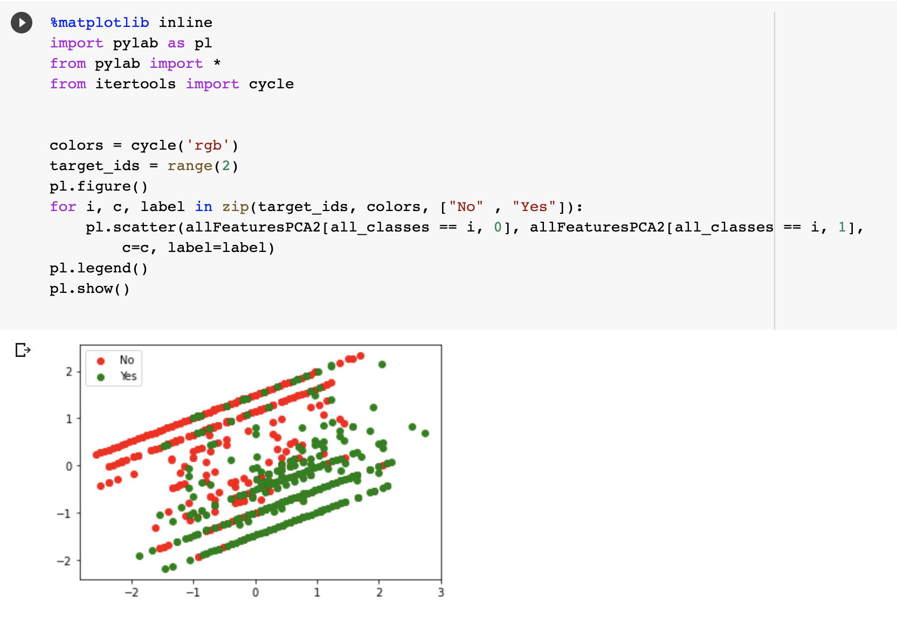
Plotting the features

Slide 60
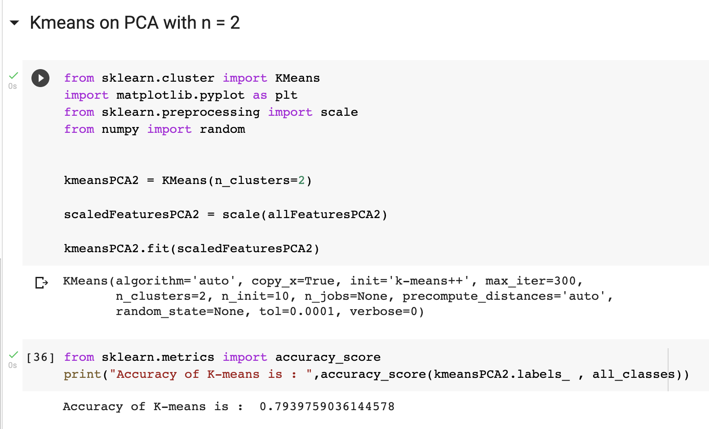
K-Means with 2 Components

Slide 61
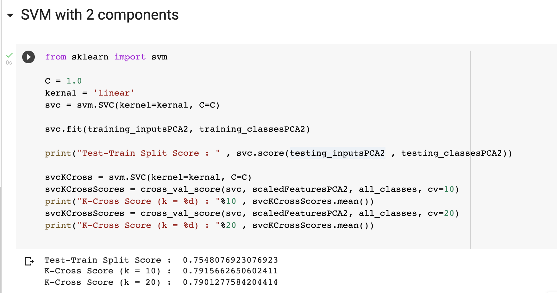
SVM with 2 Components

Slide 62
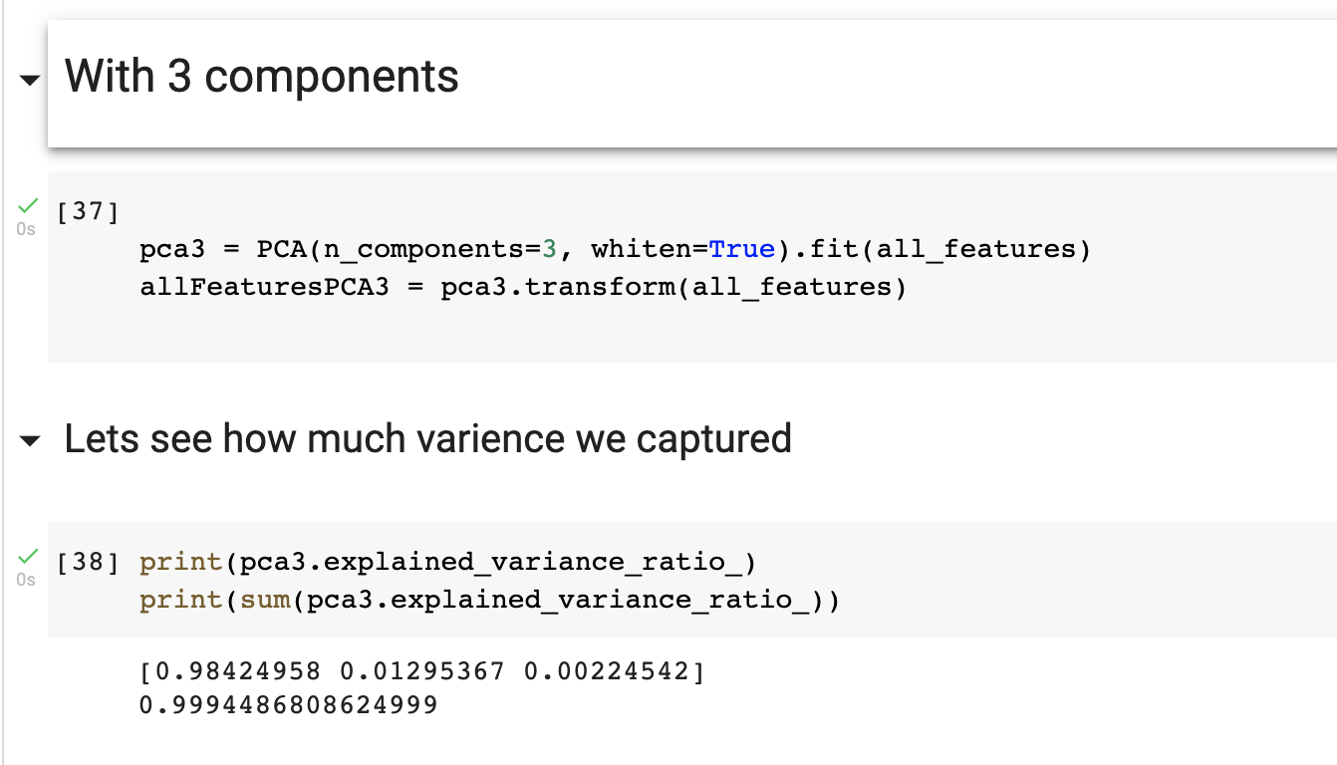
API USED FROM SKLEARN

Slide 63
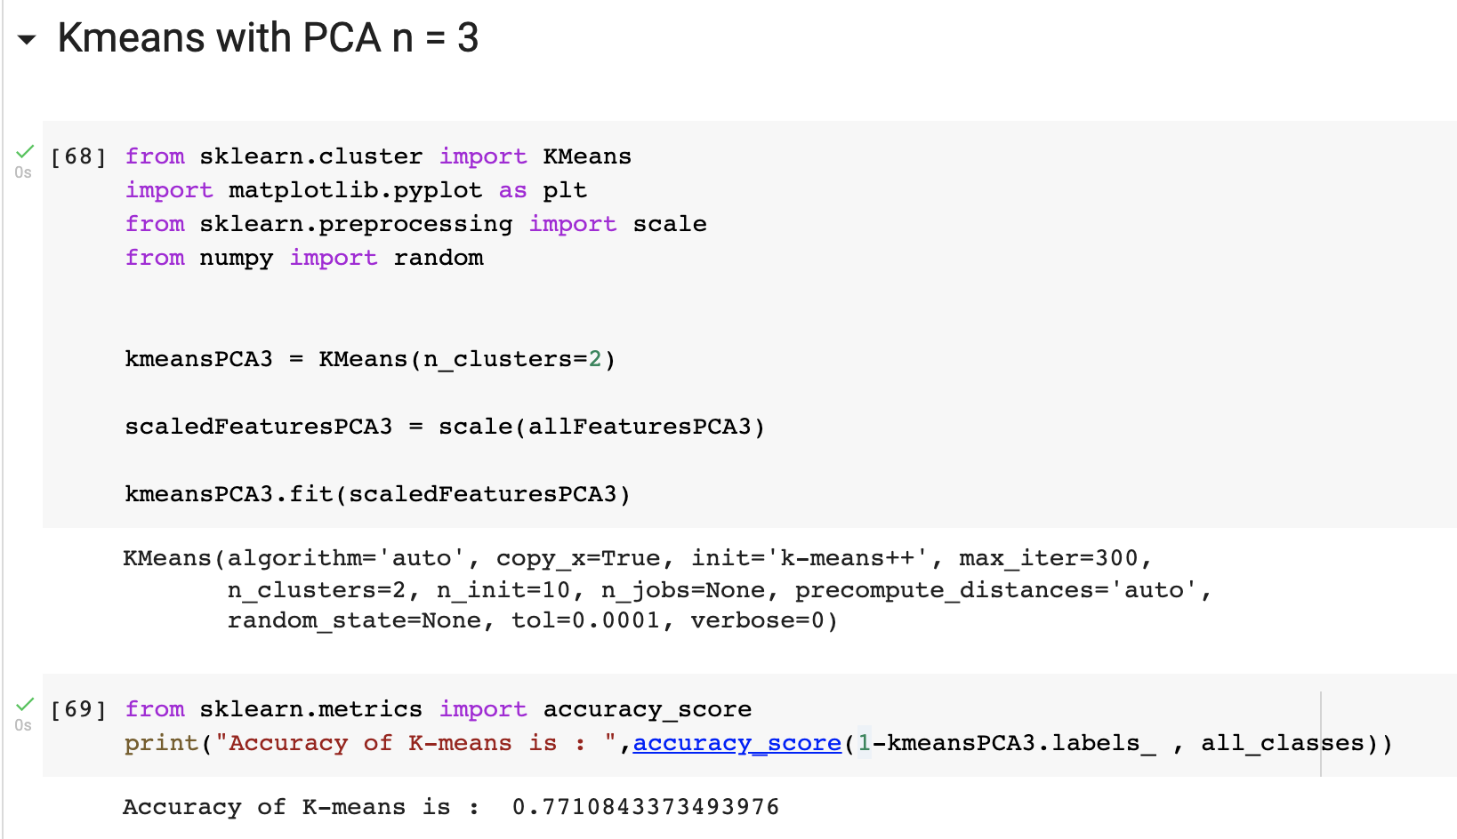
K-Means with 3 Components

Slide 64
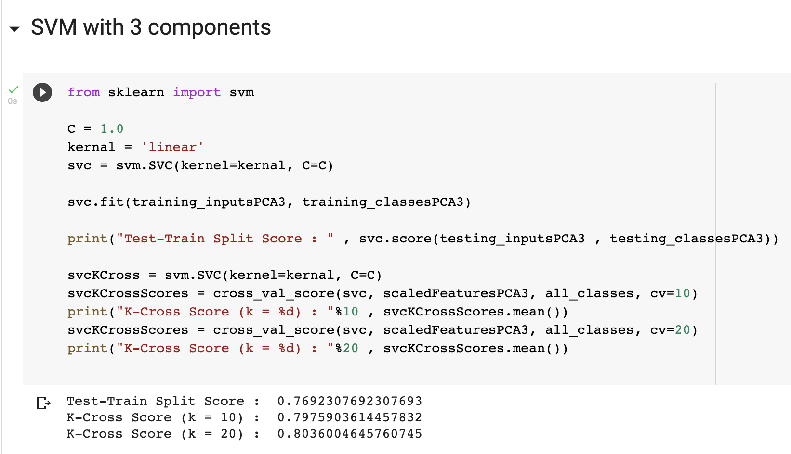
SVM with 3 Components

Slide 65
Ensemble learning

Slide 66
Ensemble learning is the process by which multiple models, such as classifiers or experts, are strategically generated and combined to solve a particular computational intelligence problem. Ensemble learning is primarily used to improve the (classification, prediction, function approximation, etc.) performance of a model, or reduce the likelihood of an unfortunate selection of a poor one. Other applications of ensemble learning include assigning a confidence to the decision made by the model, selecting optimal (or near optimal) features, data fusion, incremental learning, nonstationary learning and error-correcting. This article focuses on classification related applications of ensemble learning, however, all principle ideas described below can be easily generalized to function approximation or prediction type problems as well.

Slide 67
TYPES OF ENSEMBLE LEARNING
Bagging
Bagging, which stands for bootstrap aggregating, is one of the earliest, most intuitive and perhaps the simplest ensemble based algorithms, with a surprisingly good performance (Breiman 1996). Diversity of classifiers in bagging is obtained by using bootstrapped replicas of the training data.
Boosting
Similar to bagging, boosting also creates an ensemble of classifiers by resampling the data, which are then combined by majority voting. However, in boosting, resampling is strategically geared to provide the most informative training data for each consecutive classifier
AdaBoost
Arguably the best known of all ensemble-based algorithms, AdaBoost (Adaptive Boosting) extends boosting to multi-class and regression problems
Stacked Generalization
In Wolpert's stacked generalization (or stacking), an ensemble of classifiers is first trained using bootstrapped samples of the training data, creating Tier 1 classifiers, whose outputs are then used to train a Tier 2 classifier (meta-classifier) (Wolpert 1992). The underlying idea is to learn whether training data have been properly learned.

Slide 68

SELF IMPLEMENTED ENSEMBLE APPROACH

Slide 69

TRAINING THE MODELS INSIDE ENSEMBLE CLASS

Slide 70

Accuracy of The ENSEMBLE APPROACH
Prediction is made after taking linear combination of predictions and accepting if >70% of models agree

Slide 71
Machine Learning Assignment
Ujjwal Sharma - BT18CSE021

